Slide 1
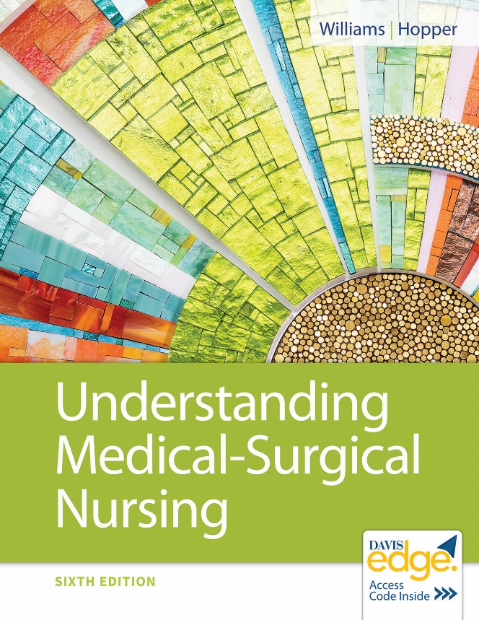
Chapter 11
Nursing Care of Patients With Cancer

Slide 2
Learning Outcomes
Explain the structures and functions of the normal cell.
Describe changes that occur in a cell when it becomes malignant.
Identify commonly used chemotherapeutic agents.
Discuss the plan of care for the patient receiving chemotherapy and/or radiation therapy.

Slide 3
Learning Outcomes (continued)
Identify data to collect when caring for a patient with cancer.
Recognize common oncological emergencies and related nursing care.
Discuss how you will know if your nursing interventions have been effective.
Describe the role of hospice in providing care for patients with advanced cancer.

Slide 4
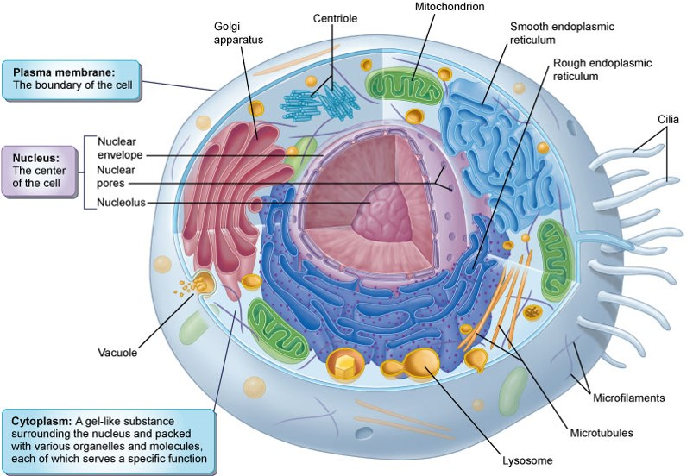
Review of Anatomy and Physiology of Normal Cells

Slide 5
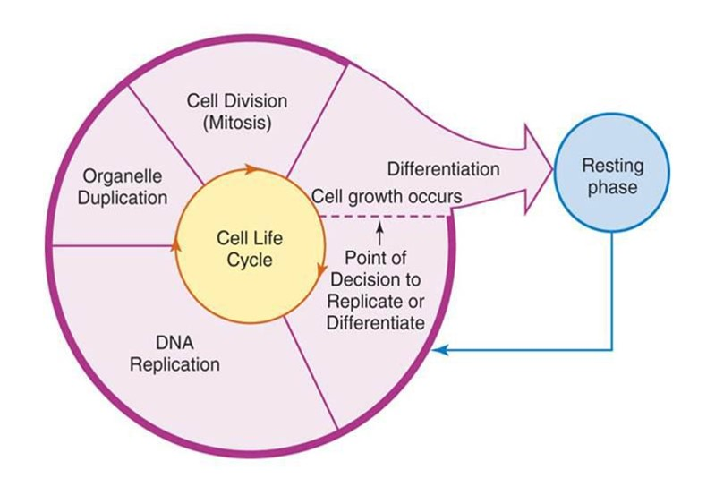
Cell Cycle

Slide 6
Cancer Concepts
Neoplasm
Benign
Malignant

Slide 7
Cancer Pathophysiology
Mutation of cellular genes
Abnormal cell growth
No cell division limit
Lack of contact inhibition

Slide 8
Etiology
Carcinogen exposure
Cancer cell growth and reproduction
Initiation
Promotion
Progression

Slide 9
Risk Factors
Oncoviruses
Radiation
Chemicals
Irritants
Genetics
Diet
Hormones
Immune factors

Slide 10
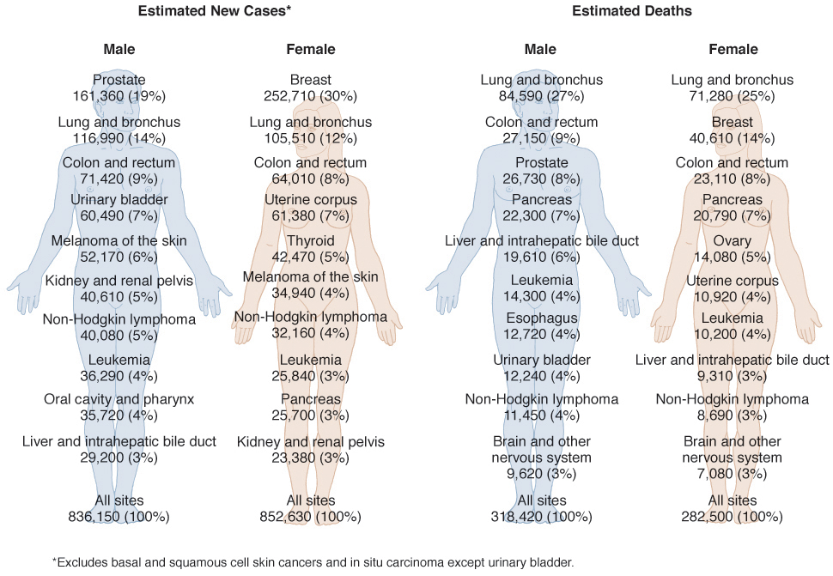
Cancer Statistics

Slide 11
Cancer Types
Carcinoma
Sarcoma
Leukemia
Lymphoma
Melanoma

Slide 12
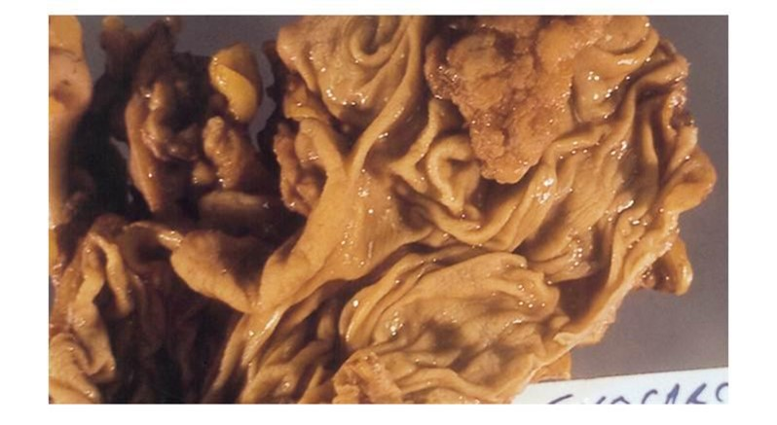
Adenocarcinoma of the Caecum

Slide 13
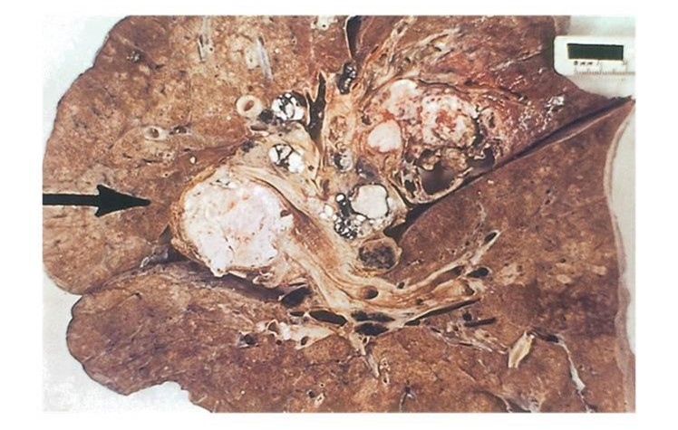
Lung Cancer

Slide 14
Metastasis
Invade blood or lymph vessels
Move by mechanical means
Lodge and grow in new location

Slide 15
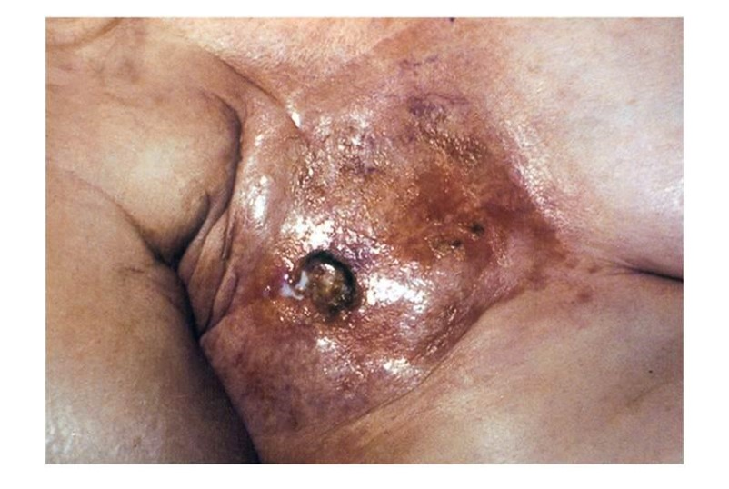
Metastasis to Skin

Slide 16
Most Common Cancers
Men
Prostate
Lung
Colon
Women
Breast
Lung
Colon

Slide 17
Prevention
Early detection
Regular screening
Genetic testing
Healthy lifestyle
Protectant foods
Folate
Fruits and vegetables
Vaccines

Slide 18
Diagnosis
Biopsy
Radiological studies
Nuclear imaging procedures
Ultrasound procedures
Magnetic resonance imaging
Endoscopy
Laboratory tests
Cytological study

Slide 19
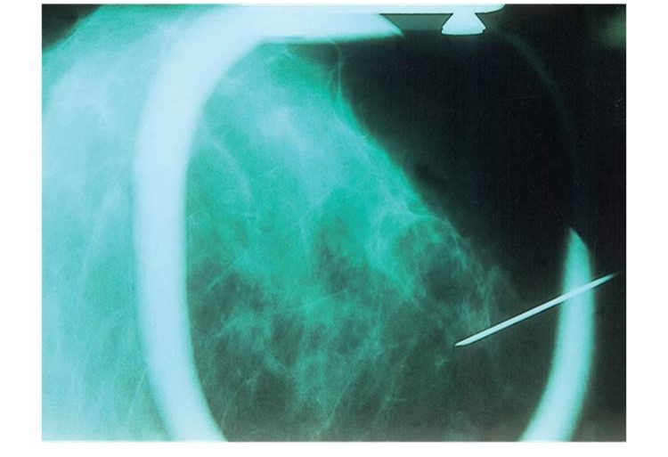
Fine Needle Biopsy

Slide 20
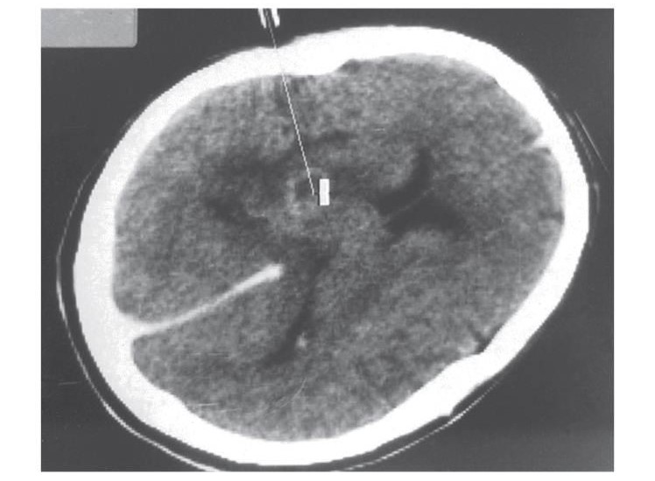
Stereotactic Biopsy

Slide 21
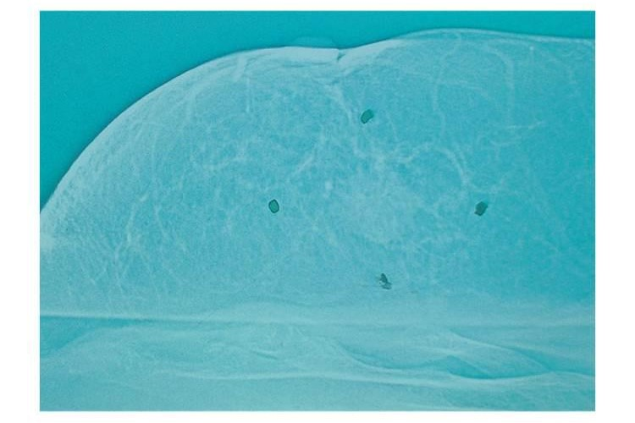
Mammogram

Slide 22
Staging
Tumor
Nodes
Metastasis

Slide 23
Therapeutic Interventions
Surgery
Radiation therapy
Chemotherapy

Slide 24
Side Effects of Radiation
Fatigue
Nausea, vomiting, anorexia
Mucositis
Xerostomia
Skin reactions
Bone marrow depression

Slide 25
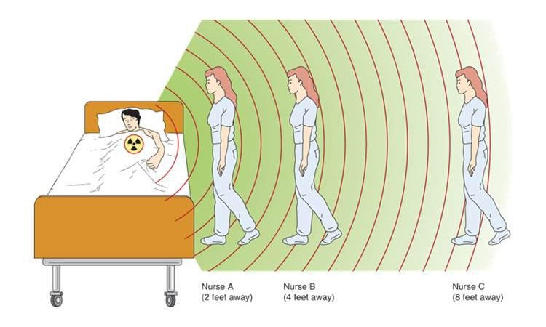
Radiation Safety
Time
Distance
Shielding

Slide 26
Chemotherapy
Action
Routes of administration
Combination chemotherapy

Slide 27
Side Effects of Chemotherapy
Bone marrow depression at nadir
Leukopenia
Thrombocytopenia
Anemia
Nausea, vomiting, diarrhea
Stomatitis
Alopecia
Reproductive alterations
Neurotoxicity

Slide 28
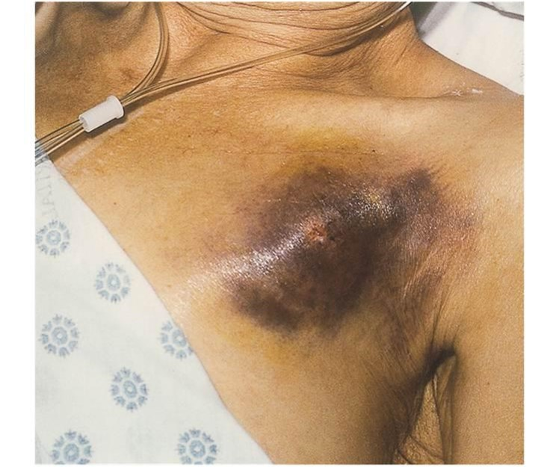
Chemotherapy Extravasation

Slide 29
B I T E S
Bleeding
Infection
Tiredness
Emesis
Skin changes

Slide 30
Colony Stimulating Factors
Granulocyte–colony-stimulating factor (G-C S F)
Granulocyte–colony-stimulating factor (G-C S F)
Erythropoietin
Interleukin-Two

Slide 31
Nursing Diagnoses
Ineffective Coping
Acute or Chronic Pain
Risk for Infection
Ineffective Protection
Imbalanced Nutrition
Grieving
Social Isolation
Disturbed Body Image

Slide 32
Survivorship
Ongoing care needs
Medical
Physical
Psychosocial

Slide 33
Hospice Care
Less than 6-month prognosis
Inpatient
Outpatient
Interdisciplinary team
Family/caregivers

Slide 34
Oncological Emergencies
Superior vena cava syndrome
Spinal cord compression
Hypercalcemia

Slide 35
Review Question
The nurse is reviewing lab data of a Stage 4 breast cancer patient. What lab data may indicate further metastasis?
Potassium 3.4 milliequivalents per liter
Calcium 12.5 milligrams per deciliter
Sodium 138 milliequivalents per liter
Hemoglobin 10.5 grams per deciliter

Slide 36
Review Question Answer
Correct Answer: 2

Slide 37
Review Question (continued_1)
What does M0 stand for in the tumor-node-metastasis (T N M) staging system?
Distant metastasis
Proximal metastasis
No metastasis
Unable to evaluate metastasis

Slide 38
Review Question Answer (continued_1)
Correct Answer: 3

Slide 39
Review Question (continued_2)
Which principles are essential for maintaining safety when working with patients with radioactive implants? Select all that apply.
Caring
Time
Distance
Communication
Shielding

Slide 40
Review Question Answer (continued_2)
Correct Answer: 2, 3, 5

Slide 41
Review Question (continued_3)
Which nursing interventions are appropriate for a patient with thrombocytopenia? Select all that apply.
Limit visitors.
Protect from injury.
Report bruising or bleeding.
Avoid unwashed fruits or vegetables.
Administer oxygen as ordered.

Slide 42
Review Question Answers (continued_3)
Correct Answer: 2, 3

Slide 43
Review Question (continued_4)
The nurse is preparing a teaching plan for a patient being transferred to hospice services. What should the nurse include in teaching? Select all that apply.
Hospice care promotes quality of life.
Hospice is a private pay facility.
A new physician will provide all care oversight.
Hospice provides an interdisciplinary and holistic plan of care.
Hospice care helps families up to 1 year after patient death.

Slide 44
Review Question Answer (continued_4)
Correct Answer: 1, 4, 5

